Slide 1
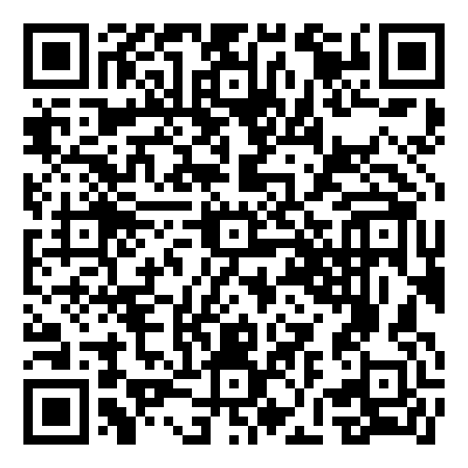
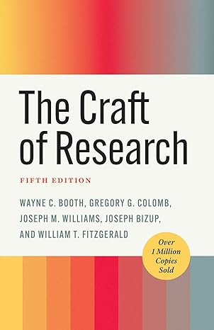
New Humanities Book Information from UNIV. CO-OP
リサーチの技法 第5版
The Craft of Research, 5th ed.
※大学生協洋書オンラインストアの
該当商品のページへ
2024年7月
刊行予定
A thoroughly updated edition of a beloved classic that has guided generations of researchers in conducting effective and meaningful research.
With more than a million copies sold since its first publication, The Craft of Research has helped generations of researchers at every level—from high-school students and first-year undergraduates to advanced graduate students to researchers in business and government. Conceived by seasoned researchers and educators Wayne C. Booth, Gregory G. Colomb, and Joseph M. Williams, this fundamental work explains how to choose significant topics, pose genuine and productive questions, find and evaluate sources, build sound and compelling arguments, and convey those arguments effectively to others.
While preserving the book’s proven approach to the research process, as well as its general structure and accessible voice, this new edition acknowledges the many ways research is conducted and communicated today. Thoroughly revised by Joseph Bizup and William T. FitzGerald, it recognizes that research may lead to a product other than a paper—or no product at all—and includes a new chapter about effective presentations. It features fresh examples from a variety of fields that will appeal to today’s students and other readers. It also accounts for new technologies used in research and offers basic guidelines for the appropriate use of generative AI. And it ends with an expanded chapter on ethics that addresses researchers’ broader obligations to their research communities and audiences as well as systemic questions about ethical research practices.
This new edition will be welcomed by a new and more diverse generation of researchers.
●著者：Booth, Wayne C./Colomb, Gregory G./Williams, Joseph M./Bizup, Joseph/Fitzgerald, William T.
●出版社：The University of Chicago Press Editorial Staff
●ISBN：978-0-226-82667-7
● paper/368P.
●刊行：2024年6月​
組合員価格は生協店舗にお尋ねください
＊海外からの仕入れのため為替レートの変動により価格は変動します。
研究費・科研費でのご購入は生協が便利で安心！
注文書
リサーチの技法第5版 /The Craft of Research, 5th ed. ご注文 冊
氏名: TEL: お支払方法（○で囲む） 校費・私費
学部名； 学科名： 研究科or研究室名：
大学生協洋書オンラインストア
https://yosho.univcoop.jp/BookShop/
発行：2024年5月28日

